Slide 1

Financial Risk Management
Spring 2016
Dr. Ehud Peleg
Class 1 - Introduction

Slide 2
Agenda
What is risk management?
Risk Appetite Framework
Syllabus
Course Topics

Slide 3
Risk Management
A process for identification, assessment, control, or mitigation of risks in business decision making.
Fit Risk Appetite?
Identify/
Assess
Accept
Control/
Manage
Mitigate
Undo/Hedge/
Insure

Slide 4
Risk Appetite Framework
Derived from the firm’s business strategy, culture and governance.
Allows to decide whether to accept a specific risk and control it, or to mitigate it.
Defines a language, which allows to communicate among all stakeholders, internal and external.
Includes targets, preferences, escalation thresholds, limits and capacities.
For most part, quantitative, but also qualitative.

Slide 5
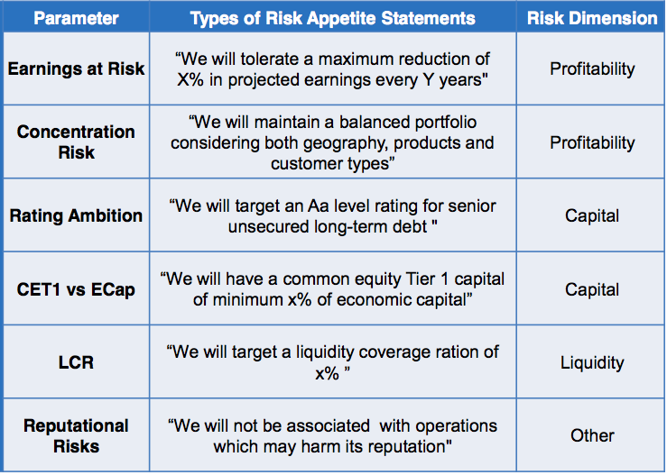
Example of a Risk Appetite Statement
Adapted from “Risk as a Growth Enabler” – Adem Yilmaz – CRO, Hyundai Capital America

Slide 6
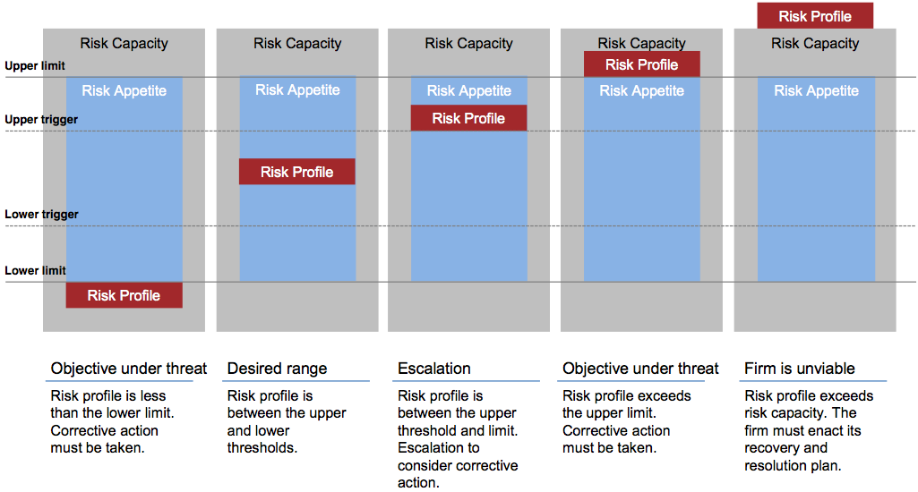
Monitoring Risk Profile vs Risk Appetite
Adapted from “Risk as a Growth Enabler” – Adem Yilmaz – CRO, Hyundai Capital America

Slide 7
Risk Management Process
Fit Risk Appetite?
Identify/
Assess
Accept
Control/
Manage
Mitigate
Undo/Hedge/
Insure

Slide 8
Risk Assessment
Common ways to assess the nature and severity of risks:
Risk statistics
Moments of return distribution: standard deviation, skewness, kurtosis
Sensitivity to underlying: Greeks, Duration
“What if?” analysis:
Scenario analysis: shock a single underlying factor and compute potential losses
Stress testing: portfolio behavior given a stressful economic scenario
Compute the “worst-case” scenario at a certain confidence level (i.e. probability)
Value at Risk (VaR)
Expected Shortfall (ES), Conditional VaR (CVaR)

Slide 9
Risk Assessment (Cont.)
Risk Assessment and Control are performed on multiple levels:
Single Exposure
Credit Scoring/Rating
Interest Rate Sensitivity
Risk-Return Metrics
Portfolio Risk
Economic Capital / VaR
Stress Testing
Diversification

Slide 10
Risk Management Process
Fit Risk Appetite?
Identify/
Assess
Accept
Control/
Manage
Mitigate
Undo/Hedge/
Insure

Slide 11
Risk Mitigation
Hedging – eliminating both upside and downside
Insurance – protecting against unfavorable events and keeping potential upside; typically involves paying a premium
Diversification – holding a large collection of imperfectly-correlated assets to minimize idiosyncratic risks

Slide 12
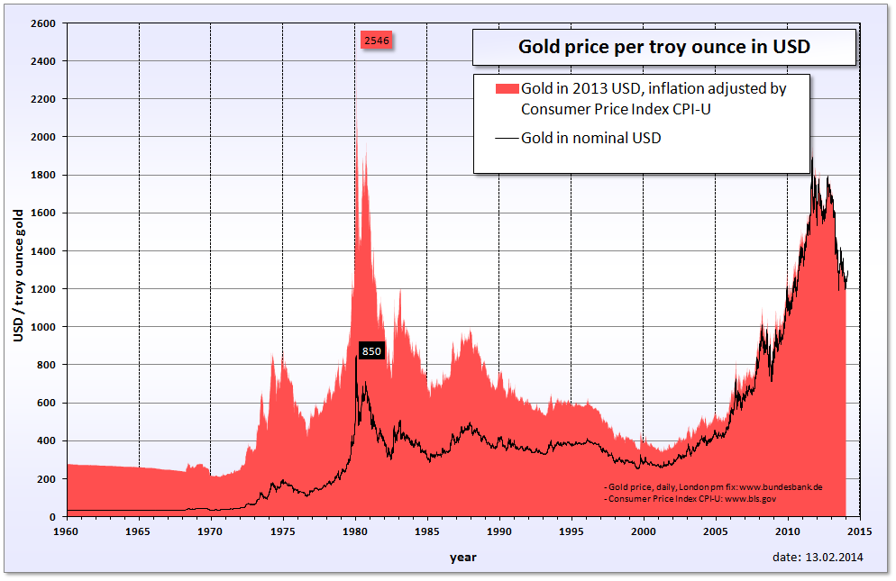
Risk Mitigation or Speculation?
2009 - Spends $5.6B to get out of hedges
1993 - Barrick starts hedging program
2014 – New CEO says: “Hedging makes sense, should be considered”

Slide 13
Why Hedge?
If the firm has “unfair” advantage over investors:
Expertise and cost advantages in industry-specific markets
Firm has more accurate information about current exposures and future prospects
If cash flow variability can affect firm’s liquidity or interrupt its long-term investment activity.
Reduce earnings volatility and dividend volatility, as signals of management quality to shareholders

Slide 14
Why Not Hedge?
It may increase risk to hedge when competitors do not.
Explaining a situation where there is a loss on the hedge and a gain on the underlying can be difficult.
Bid-Ask spread is larger for futures and options than spot.
Employee costs and the cost of aligning their incentives to prevent speculation.

Slide 15
Risk Aware Business Management
Modern Risk Management supports the organization above and beyond assessment/control/mitigation:
Risk adjusted profitability and measurement
Risk-based pricing
Risk-minded culture and incentives

Slide 16
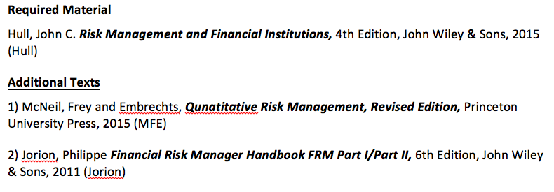
Syllabus
Grading: Problem Sets 30% , Midterm 30%, Final 40%
My email: ehud.peleg@anderson.ucla.edu
Office hours: Thursday 11.30am-1pm, C404
TA: Yuji Sakurai

Slide 17
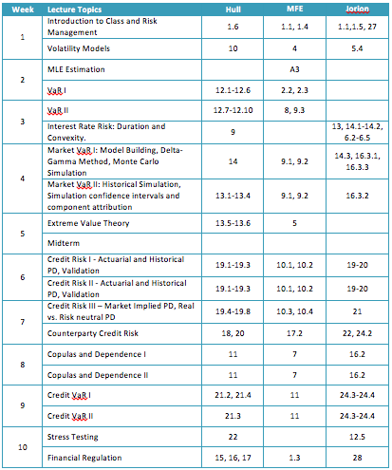
Foundations
Market Risk
Credit Risk
Enterprise RM

Slide 18
Foundations
Market Risk
Credit Risk
Enterprise RM

Slide 19
Volatility Models
The most common risk measure
Especially in trading market risk management
Serves as building block for VaR calculations
Estimation:
Historical, i.i.d. assumption
Model-based, serial correlation: EWMA and GARCH
Implied, from option prices
Sensitivity and Scenario Analysis for changes in volatility

Slide 20
Maximum Likelihood Estimation
Statistical Framework for fitting models and testing hypotheses
We use it throughout the course:
Estimate volatility models
Fit credit risk models
Framework for backtesting VaR
Fit copula models

Slide 21
Value at Risk
Answers “How bad can things get?” in one parameter:
“We are X percent certain that we will not lose more than Y dollars in time T.”
We cover:
Basic models (discrete and continuous)
Desirable and undesirable properties of tail measures
Alternative tail measures (Expected Shortfall)
Aggregation, Attribution and Allocation
Confidence Intervals
Back-testing

Slide 22
Foundations
Market Risk
Credit Risk
Enterprise RM

Slide 23
Market Risk
Uncertainty concerning changes in market prices and rates (including interest rates, equity prices, fx rates and commodity prices), the correlations among them and their levels of volatility.
Examples:
Investment portfolio facing equity price risk
Company expecting a payment in Foreign Currency
Effect of exchange rate on competitiveness in foreign markets
Farmer intending to sell wheat
Homebuyer taking Adjustable Rate Mortgage (ARM)

Slide 24
Interest Rate Risk
The basic interest rate risk:
Bond value is equal to the discounted value of all future payments.
If rates increase, the value of the bond decreases.
Risk Tools:
Sensitivity is measured by Duration and Convexity
Scenario analysis: what is the effect of change in one interest rate, or shifts in term structure?
Set up the tools to find the “worst-case” scenario of a bond portfolio.
Consider additional interest rate risks: basis risk, term-structure shape, behavioral options (prepayment risk), etc.

Slide 25
Market Risk VaR
We analyze the distribution of future returns, with focus on the tails.
Two main issues:
Should we make distributional / parametric assumptions, or make a non-parametric evaluation?
How can we analyze the return distribution of a portfolio that has many positions, some that are time consuming to re-price?
Modeling heavy tails – Extreme Value Theory

Slide 26
Foundations
Market Risk
Credit Risk
Enterprise RM

Slide 27
Credit Risk
Risk of default by
Obligor/counterparty/borrower/debt issuer
which leads to failure to meet contractually obligated payments
in relation to actual, contingent or potential claims.
Examples
Loans: Mortgages, Commercial & Industrial, Commercial Real Estate
Lines of Credit, Guarantees
Trade Credit
Counterparty Credit Risk
Credit Default Swap

Slide 28
Topics in Credit Risk (1)
Probability of Default – PD
What is the chance that a borrower will not pay back the loan, or make payment on a bond?
We will look at how we deduce this probability from:
Historical information about defaults (How to build a model and how to validate it).
Market prices.

Slide 29
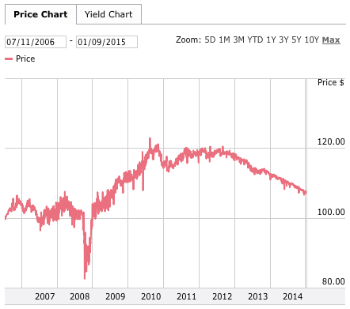
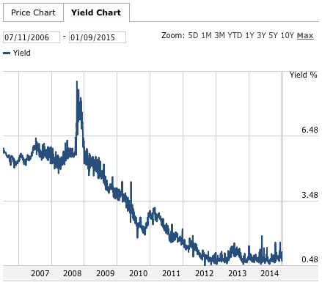
What does price tell us about PD?
TARGET CORP.
Coupon 5.875%
Maturity 07/15/2016

Slide 30
Topics in Credit Risk (2)
Loss Given Default – LGD
Suppose the borrower defaults, what portion of the debt will we lose?
LGD = 1 – Recovery Rate
How is this correlated with the probability of default?

Slide 31
Topics in Credit Risk (3)
Exposure At Default – EAD
What will be our exposure to the obligor if it defaults?
In what cases might this be unknown at time zero?

Slide 32
Counterparty Credit Risk
Suppose we agree to buy 1000bbl of crude forward at $80 from JP Morgan, what is our exposure if JP Morgan defaults tomorrow?
If the price of oil is $80? $90? $60?
What will be our exposure if JP Morgan defaults in a week? What if both sides post collateral every day?
What is our credit exposure to JP Morgan if we sold (wrote) it a put option on oil?

Slide 33
Dependency of Credit Defaults
How do we model a degree of dependency between credit exposures or bonds?
Example:
An insurer is selling protection on two bonds that will pay out if both bonds default
Is the insurance worth more if the bonds are independent or if their perfectly dependent?
What if the insurance pays out if either of the bonds defaults?

Slide 34
Credit VaR
It is harder to limit downside of credit portfolios by diversification than equity portfolios:
Discrete nature of each credit
Bulkiness of credits
Contagion and dependence effects
Credit portfolios usually have many more loans/bonds than stock portfolios
How do we model the dependency structure among thousands of loans?

Slide 35
Foundations
Market Risk
Credit Risk
Enterprise RM

Slide 36
Stress Testing
Assessing tail risk through scenarios (stories) rather than statistical VaR.
How do we translate stories into portfolio losses?
How do we know the probability of the scenario? Is it severe enough?
Big advantage: Can point us to the cause of the problem, and help us think about a mitigation plan.

Slide 37
Financial Regulation
Focused on guaranteeing bank survival:
Solvency – Using Capital as a cushion for losses
Liquidity – Examine funding under stress scenarios
Basel frameworks historically focused on capital adequacy (leverage).
Following the crisis, attention to liquidity has increased.
Dodd-Frank Act – Regulating bank activities to limit systemic risks.

Slide 38

Operational Risk
Operational Risk – Potential of failure in relation to employees, contractual specifications and documentation, technology, infrastructure failure and disasters, external influences and customer relationships.
Examples:
Fire, Earthquake, Mudslide
Internal/external fraud
Teller/dealer mistakes
Cyber-attack

Slide 39
Liquidity Risk
Liquidity Trading Risk, Liquidity Market Risk – Inability to sell an asset in a short time in the required quantity without affecting price.
A type of Market Risk
Liquidity Funding Risk – Inability to meet all payment obligations when they come due, or only being able to meet these obligations at excessive costs
Typically a result of other risks
A major cause of many financial failures

Slide 40
Other Risks
Business or Strategic Risk – Risk due to potential changes in general business conditions, such as market environment, client behavior and technological progress
Compliance or Legal Risk – Risks that the firm will be exposed to regulatory actions, be fined, or incur increased legal expenses (sometimes included in Operational Risk)
Reputational Risk – Risk that bad publicity will impact the public’s trust in the organization
Insurance Risks – Risks affecting size and timing of insurance and pension obligations, such as longevity and mortality risks

Slide 41
Interaction of Risks
Market Risk causing Credit Risk
Russian default in August 1998
Savings & Loan Debacle of 1980s
Operational Risk causing Market Risk
Barings collapse due to unauthorized trading and high volatility in Japanese stock index
Operational Risk causing Credit Risk
Mortgage Loan Buybacks
Credit Risk causing Market Risk
AIG Credit downgrade
Credit availability on October 1987
Wrong-way risk - occurs when there is a correlation between the counterparty’s credit risk and the exposure to that counterparty.

Slide 42
Thanks

